Slide 1


NEXT GEN EMPLOYABILITY PROGRAM
CREATING A FUTURE-READY WORKFORCE
Student Name :
Ugge Aravind
Student ID :
College Name :
STU67950747111cd1737819975
Malla Reddy College Of Engineering And Technology

Slide 2
CAPSTONE PROJECT SHOWCASE
Project Title
Recipe Sharing Platform with React and ExpressJS Framework
Abstract | Problem Statement | Project Overview | Proposed Solution | Technology Used | Modelling & Results | Conclusion | Q&A

Slide 3
Abstract
1
Purpose: The platform enables users to create, share, and save recipes, fostering a community-driven cooking experience with authentication and personalized features.
2
Technology Stack: Built using the MERN stack (MongoDB, ExpressJS, React, Node.js) with authentication for user security and Cloudinary for image storage.
3
Core Features: Users can register/login, create and edit recipes, browse community-shared recipes, and save their favorites for easy access.
4
Impact: Provides a seamless and user-friendly interface for cooking enthusiasts, encouraging engagement, knowledge sharing, and easy recipe management.

Slide 4


Problem Statement
Traditional recipe-sharing methods often lack interactivity and personalization, making it challenging for users to discover and save relevant recipes. Many existing platforms do not provide a seamless experience for users to create, store, and access their favorite recipes in one place. Additionally, there is a growing need for a user-friendly system that allows individuals to share recipes with images, detailed instructions, and ingredient lists. Ensuring data security and user authentication is crucial to protecting personalized recipe collections. Therefore, a modern, scalable, and community-driven platform is needed to enhance user engagement in recipe sharing while maintaining ease of use and accessibility.

Slide 5

Project Overview
This Recipe Sharing Platform is a web application built using the MERN stack (MongoDB, ExpressJS, React, Node.js) that allows users to create, share, and save recipes. Users can register, log in, and manage their personalized recipe collections with secure authentication via JWT. The platform supports image uploads via Cloudinary, enabling visually appealing recipe displays. It features a user-friendly interface with search and filter options for easy recipe discovery. Designed for scalability, the project fosters a community-driven experience where cooking enthusiasts can explore and contribute new recipes.

Slide 6
Proposed Solution
The Recipe Sharing Platform is a MERN stack web application designed to simplify recipe creation, sharing, and management. Users can register and log in securely using JWT authentication to access personalized features. Recipes are stored in MongoDB, allowing for efficient retrieval and management. The platform integrates Cloudinary for seamless image uploads, ensuring visually engaging recipe displays. A user-friendly interface provides easy navigation, with search and filter functionalities for quick recipe discovery. Users can save favorite recipes for later access, creating a personalized collection. The platform ensures data security and scalability, supporting a growing user base. By fostering a community-driven approach, it enhances user engagement and encourages knowledge sharing among cooking enthusiasts.

Slide 7
Technology used
Frontend (Client-Side)
React.js – For building a dynamic and responsive user interface.
React Router – For seamless navigation between pages.
Axios – For making HTTP requests to the backend.
Tailwind CSS – For styling and creating a modern UI/UX.
Backend (Server-Side)
Node.js – For server-side JavaScript execution.
Express.js – For handling API requests and routing.
Database & Storage
MongoDB & Mongoose – For storing user data and recipes efficiently.
Cloudinary – For handling image uploads and storage.

Slide 8
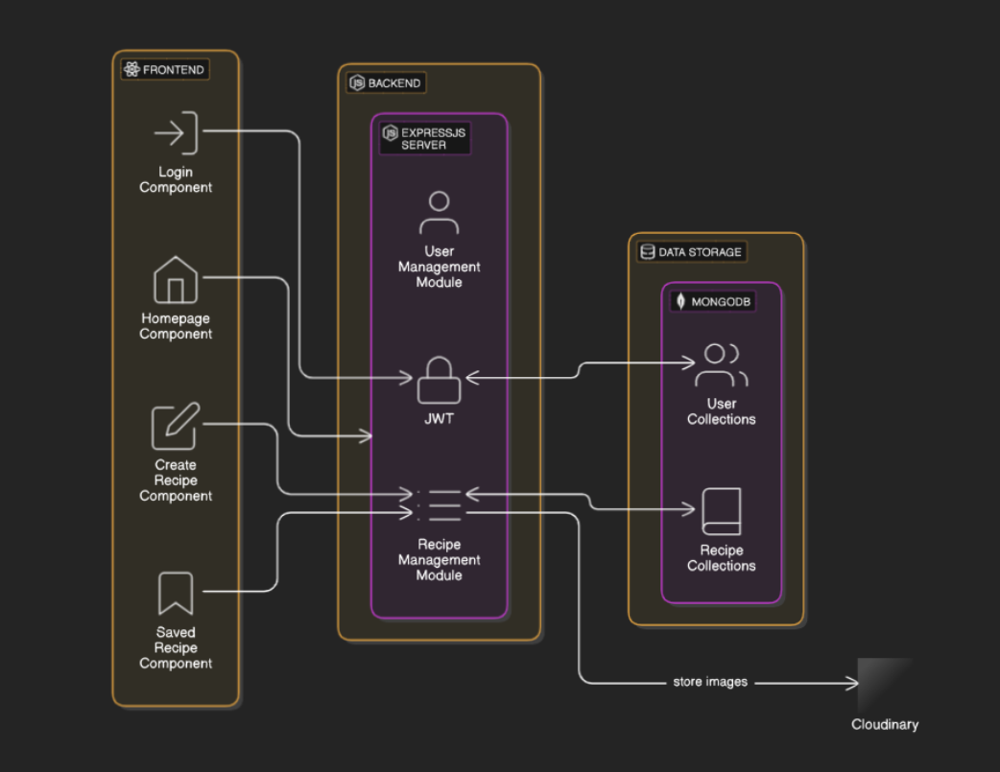
Modelling & Result
:
Architecture diagram

Slide 9
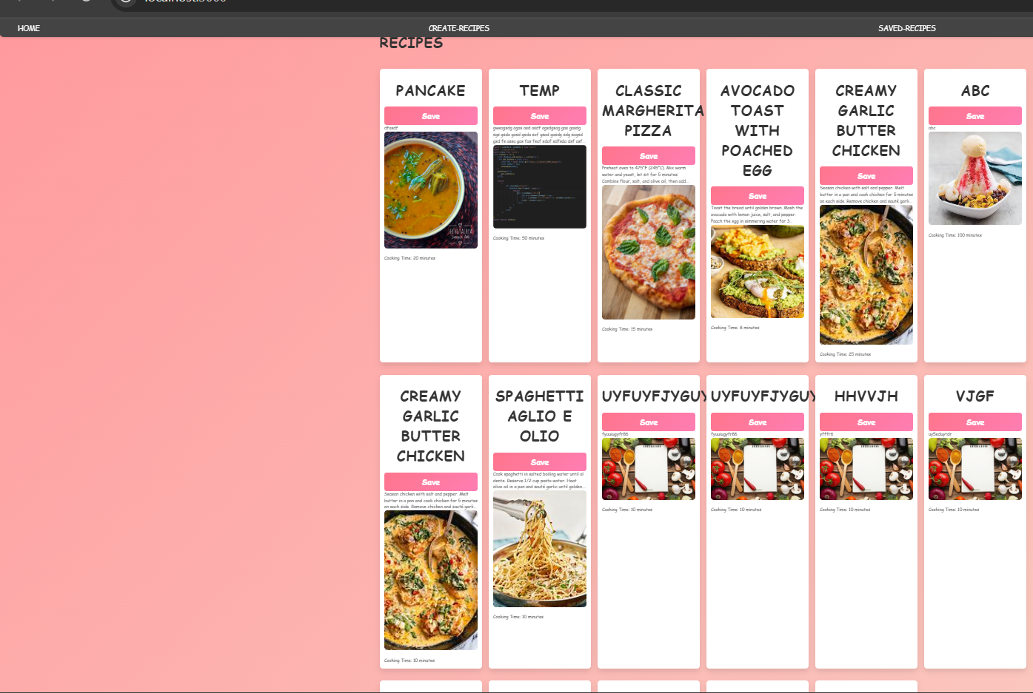
Modelling & Result
Output Screens:

Slide 10
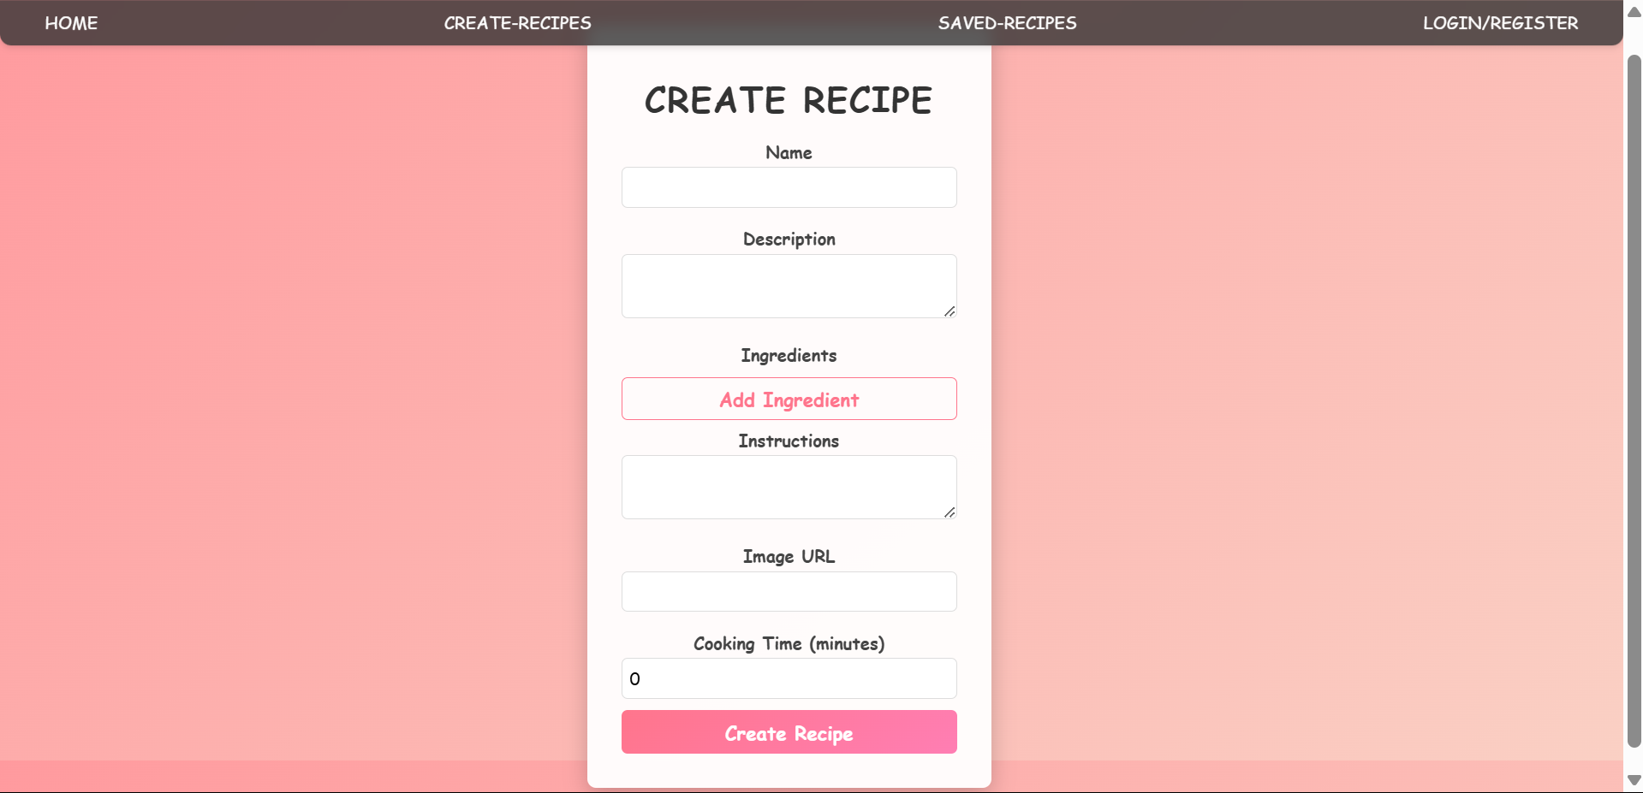
Modelling & Result

Slide 11
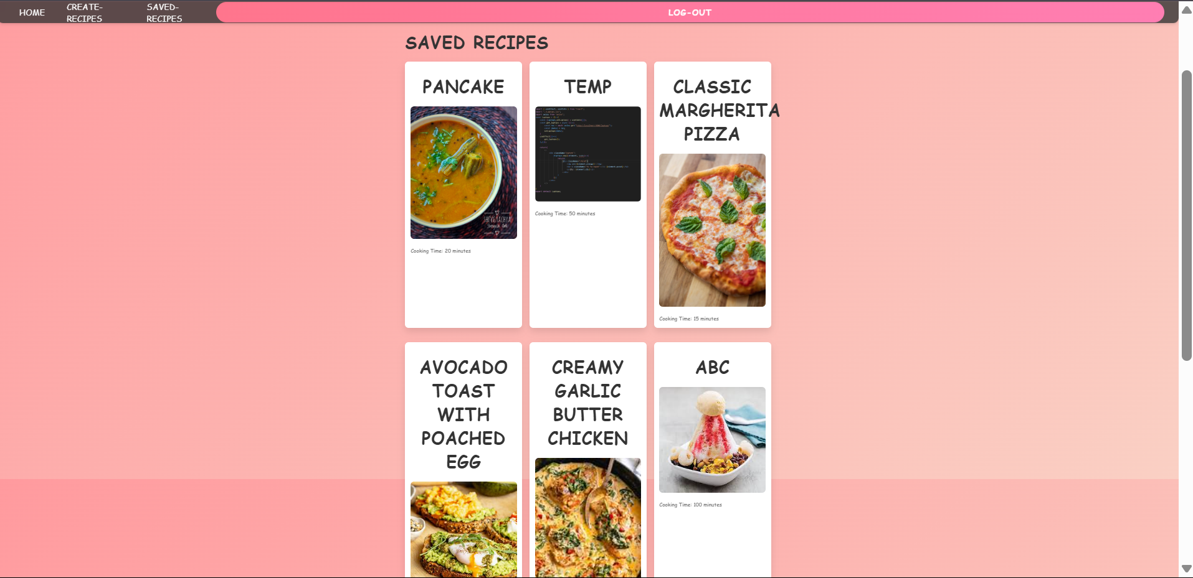
Modelling & Result

Slide 12
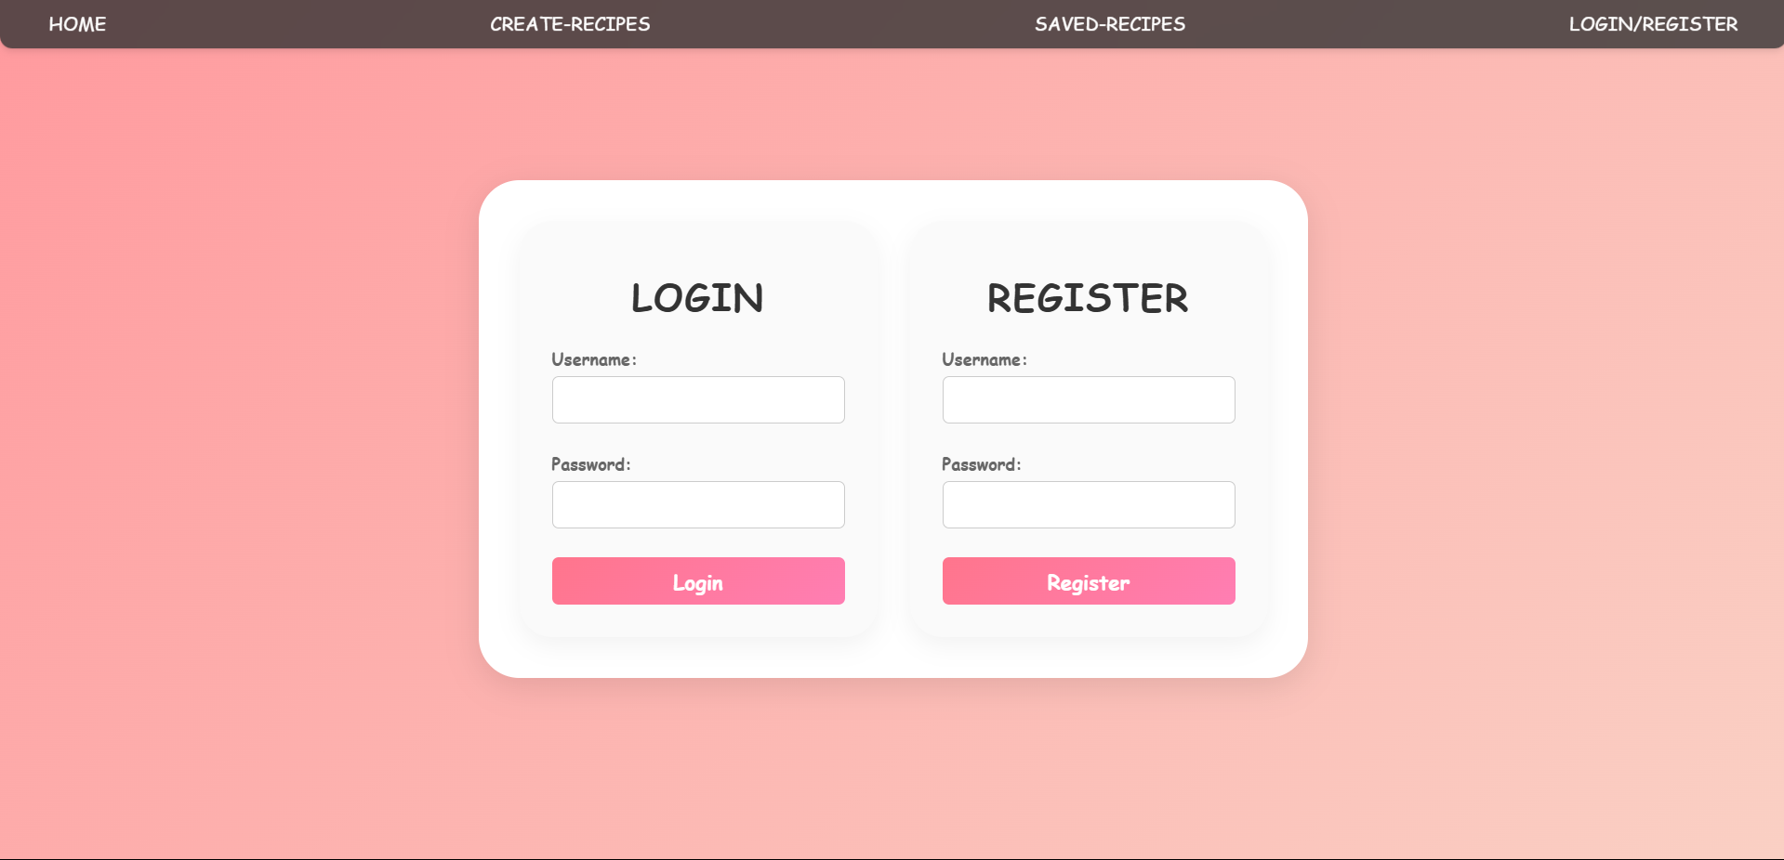
Modelling & Result

Slide 13

Conclusion
The Recipe Sharing Platform successfully provides a seamless and interactive solution for users to create, share, and save their favorite recipes. Built using the MERN stack, the platform ensures efficiency, scalability, and a user-friendly experience. With JWT authentication, MongoDB storage, and Cloudinary integration, users can securely manage their personalized recipe collections while enjoying a visually appealing interface. The inclusion of search, filter, and save functionalities enhances user engagement and accessibility. By fostering a community-driven approach, the platform encourages knowledge sharing among cooking enthusiasts, making recipe discovery and management easier than ever.

Slide 14


Notes:
Thank You !!

